Slide 1
Prediction of prospect customers response “YES” or “NO” to open a term deposit account of Bank Marketing Campaign.
Using Classification and Regression Machine Learning tools In Python
By: Marina Golberg 501072689
marina.golberg@ryerson.ca
Ryerson University: The Chang School of Continuing Education
CIND820: Big Data Analytics Project
Date: 12/03/2021
Instructor: Dr. Tamer Abdou

Slide 2
This project will be able to answer the following questions:
Will prospective customers respond "yes" or "no" to term deposit subscription?
What type of customers are more likely to subscribe to term deposit and which feature has higher influence?
What is the best time of year for a marketing campaign?

Slide 3
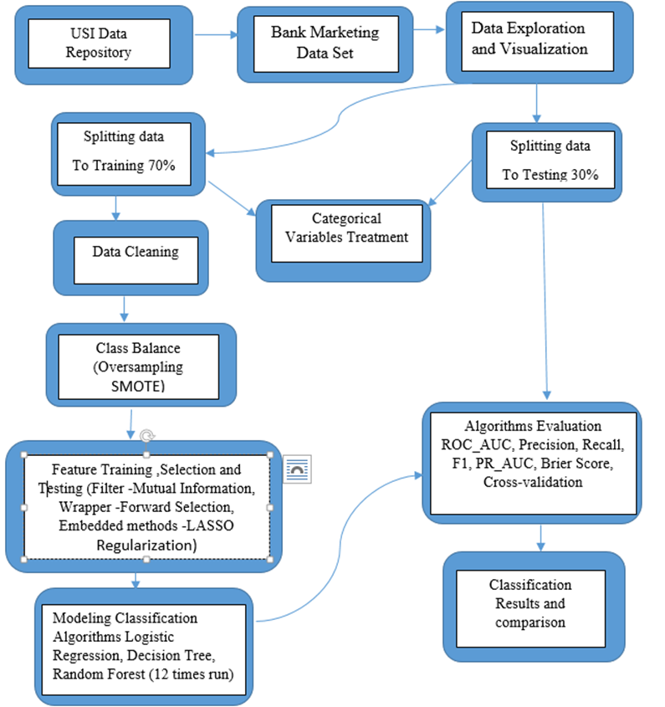
Methodology:

Slide 4
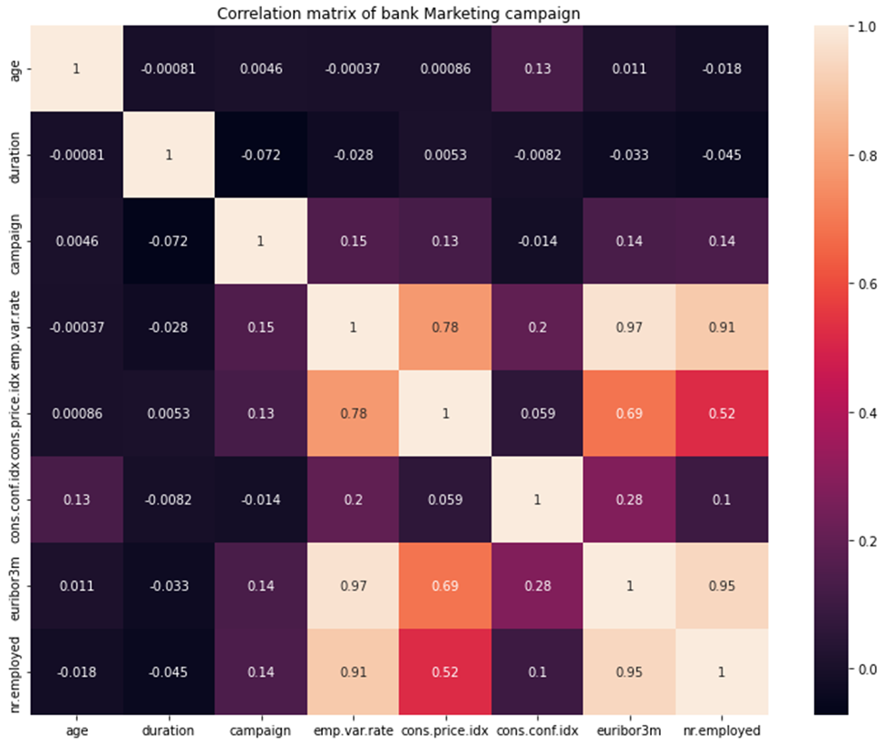
Correlation
The social and economic context attributes have correlation among themselves. All columns with a high correlation removed which is
emp.var.rate- employment variation rate
euribor3m-euribor 3 month rate
cons.conf.idx- consumer confidence index

Slide 5
Classification algorithms - Three classification algorithms have been selected to predict future subscription:
Random Forest (RF) advantages:
Not over fit
No feature scaling
Handles non-linear parameters efficiently
Decision Tree (DT) advantages:
Simple and easy
Less training period compared
Non linear parameters not affect performance
Logistic Regression (LR) advantages:
Easy to implement, interpret, and very efficient to train.
Less prone to overfitting
Efficient for binary and linear classification problems.
Random Forest disadvantages:
Complex and requires much more computational power and resources
Decision Tree disadvantages:
Overfitting
Unstable
Weak learner
Logistic Regression disadvantages:
the major limitation of Logistic Regression is the assumption of linearity between the dependent variable and the independent variables

Slide 6
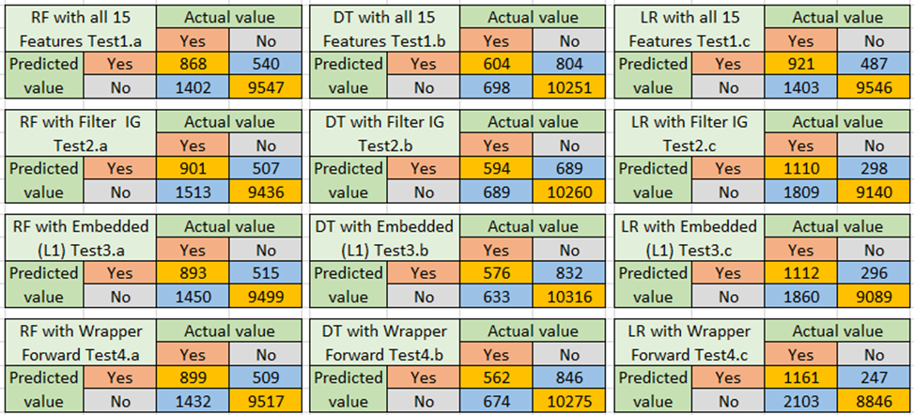
Confusion matrixes 2X2

Slide 7
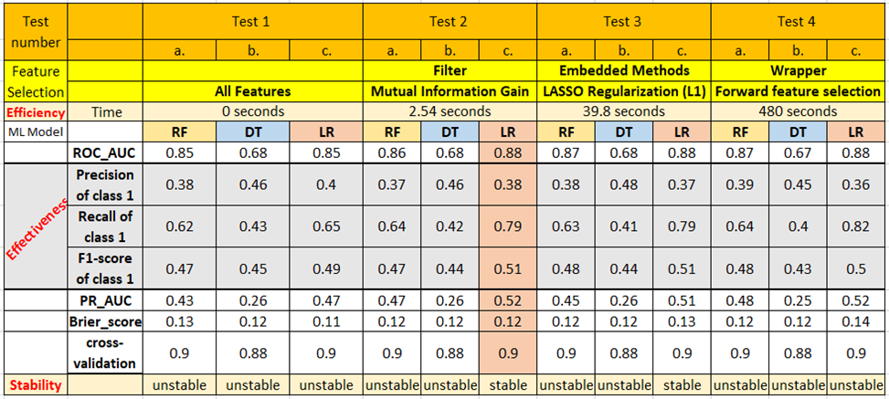
results of the Modeling

Slide 8
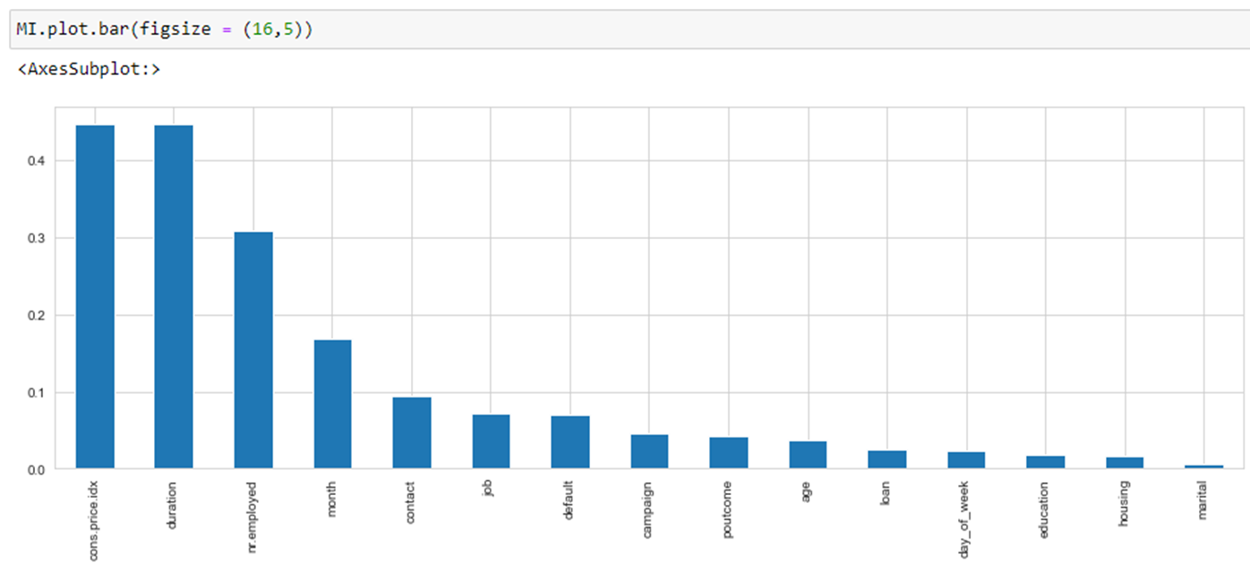
results of the feature selection
Found the most powerful features that were selected by Filter Method of Mutual Information Gain, which ranked based on evaluation of the gain of each variable in the context of the target variable.
The model ranked accordingly to importance with the best 5 feature which are 'cons.price.idx', 'duration', 'nr.employed', 'month', and 'contact'.

Slide 9
Limitation and future goals
The limitation of this research was working with Scikit-learn (Sklearn) library for classification in Python.
Not tried other libraries that are available in Python.
I have not tried other classification models.
In the future, I would like to compare the classification performances of different datasets with different methods and different packages in Python.

Slide 10
Recommendation
I recommend to bank management to hire more people to work for a bank
Improve the quality of conversation on the phone, and close the deal from the first call so there is no need to contact them many times.
I also recommend running their campaigns in the spring and summer with an emphasis on August, April, and June.
When interest rates are high and the macroeconomic environment is stable is the best time for a Marketing campaign.

Slide 11
Thank you!
Any question?
Code and documentation for this project on GitHub repository as following: https://github.com/marinagolberg/CIND820-MarGolb.git

